Slide 1
The Collection Frameworks
List

Slide 2
Stack
A stack represents a group of elements stored in LIFO(Last In First Out) order.
Stack is an ordered list of similar data type.
Stack is a LIFO(Last in First out) structure or we can say FILO(First in Last out).
push() method is used to insert new elements into the Stack and pop() method is used to remove an element from the stack. Both insertion and removal are allowed at only one end of Stack called Top.
Searching for an element in the stack called “peek”
Stack is said to be in Overflow state when it is completely full and is said to be in Underflow state if it is completely empty.

Slide 3
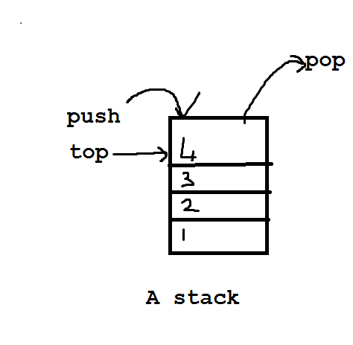
Stack with some elements
Class Stack<E>
E stands for Element type.
Stack<Integer> obj = new Stack<>();
JVM will convert into corresponding wrapper object from basic datatype i. Obj.push(i);

Slide 4
Methods in Stack class Apart from the methods inherited from its parent class Vector, Stack defines the following methods
Object push(Object element) : Pushes an element on the top of the stack.
Object pop() : Removes and returns the top element of the stack. An ‘EmptyStackException’ exception is thrown if we call pop() when the invoking stack is empty.
Object peek() : Returns the element on the top of the stack, but does not remove it.
boolean empty()
Tests if this stack is empty. Returns true if the stack is empty, and returns false if the stack contains elements.
int search(Object element) : It determines whether an object exists in the stack. If the element is found, it returns the position of the element from the top of the stack. Else, it returns -1.

Slide 5
package collections;
import java.io.*;
import java.util.*;
public class Stack_exp {
// Pushing element on the top of the stack
static void stack_push(Stack<Integer> stack)
{
System.out.println("Pushed the elements into stack");
for(int i = 0; i < 5; i++)
{
stack.push(i);
}
}
// Popping element from the top of the stack
static void stack_pop(Stack<Integer> stack)
{
System.out.println("Pop :");
if(stack.empty())
{
System.out.println("There are no elements in stack");
}else{
for(int i = 0; i < 5; i++)
{
Integer y = (Integer) stack.pop();
System.out.println(y);
}
}
}
// Displaying element on the top of the stack
static void stack_peek(Stack<Integer> stack)
{
Integer element = (Integer) stack.peek();
System.out.println("Element on stack top : " + element);
}
// Searching element in the stack
static void stack_search(Stack<Integer> stack, int element)
{
Integer pos = (Integer) stack.search(element);
if(pos == -1)
System.out.println("Element not found");
else
System.out.println("Element is found at position " + pos);
}
public static void main (String[] args)
{
Stack<Integer> stack = new Stack<Integer>();
//stack_push(stack);
// stack_pop(stack);
stack_push(stack);
stack_peek(stack);
stack_search(stack, 0);
stack_search(stack, 6);
}
}

Slide 6
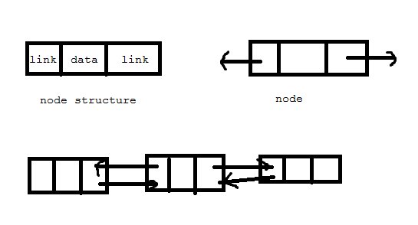
LinkedList
Linked List contains a group of elements in the form of nodes.
Each node will have three fields and the data field contains data and the link fields contains references to provide to previous and next nodes.

Slide 7
List is very convenient to store data. Inserting and removing from the linked list is done quickly and takes the same amount of time.
Important interview question:
What is the difference between a stack and Linked list?
A stack strictly follows LIFO order
A linked list does not follow any order and it can store and retrieve data randomly.
A stack generally used for the purpose of evaluation of expressions.
A linked List is used to store and retrieve data.
Insertion and deletion of elements is possible only from the top of the stack.
Insertion and deletion of elements from anywhere is possible in case of a linkedList.
class LinkedList<E>
We can create an empty linked list for storing the String type elements

Slide 8
Java LinkedList class uses a doubly linked list to store the elements. It provides a linked-list data structure. It inherits the AbstractList class and implements List and Deque interfaces.
The important points about Java LinkedList are:
Java LinkedList class can contain duplicate elements.
Java LinkedList class maintains insertion order.
Java LinkedList class is non synchronized.
In Java LinkedList class, manipulation is fast because no shifting needs to occur.
Java LinkedList class can be used as a list, stack or queue.
https://www.javatpoint.com/java-linkedlist

Slide 9
Book details display
package collections;
import java.util.*;
class Book {
int id;
String name,author,publisher;
int quantity;
public Book(int id, String name, String author, String publisher, int quantity) {
this.id = id;
this.name = name;
this.author = author;
this.publisher = publisher;
this.quantity = quantity;
}
}
public class LinkedList2 {
public static void main(String[] args) {
//Creating list of Books
LinkedList<Book> list=new LinkedList<Book>();
//Creating Books
Book b1=new Book(101,"Let us C","Yashwant Kanetkar","BPB",8);
Book b2=new Book(102,"Data Communications & Networking","Forouzan","Mc Graw Hill",4);
Book b3=new Book(103,"Operating System","Galvin","Wiley",6);
//Adding Books to list
list.add(b1);
list.add(b2);
list.add(b3);
//Traversing list
for(Book b:list){
System.out.println(b.id+" "+b.name+" "+b.author+" "+b.publisher+" "+b.quantity);
}
}
}

Slide 10
ArrayLinked List
https://www.programiz.com/java-programming/arraylist

Slide 11
Difference between ArrayList and LinkedList
ArrayList and LinkedList both implements List interface and maintains insertion order. Both are non synchronized classes.
However, there are many differences between ArrayList and LinkedList classes that are given below.
ArrayList | LinkedList
1) ArrayList internally uses a dynamic array to store the elements. | LinkedList internally uses a doubly linked list to store the elements.
2) Manipulation with ArrayList is slow because it internally uses an array. If any element is removed from the array, all the bits are shifted in memory. | Manipulation with LinkedList is faster than ArrayList because it uses a doubly linked list, so no bit shifting is required in memory.
3) An ArrayList class can act as a list only because it implements List only. | LinkedList class can act as a list , Stack, and queue both because it implements List and Deque interfaces.
4) ArrayList is better for storing and accessing data. | LinkedList is better for manipulating data.

Slide 12
Vector
Similar to ArrayList but vector is synchronized.
It means even if several threads act on vector object simultaneously the results will be reliable.
class Vector<E>
Vector(int initialCapacity)
Constructs an empty vector with the specified initial capacity and with its capacity increment equal to zero.
Vector(int initialCapacity, int capacityIncrement)
Constructs an empty vector with the specified initial capacity and capacity increment.
Vector<Integer> v = new Vector<>(101,20)– after it reaches full capacity 101 and it will be incremented to 121.

Slide 13
Add Elements to Vector
add(element) - adds an element to vectors
add(index, element) - adds an element to the specified position
addAll(vector) - adds all elements of a vector to another vector
Access Vector Elements
get(index) - returns an element specified by the index
iterator() - returns an iterator object to sequentially access vector elements
Remove Vector Elements
remove(index) - removes an element from specified position
removeAll() - removes all the elements
clear() - removes all elements. It is more efficient than removeAll()

Slide 14
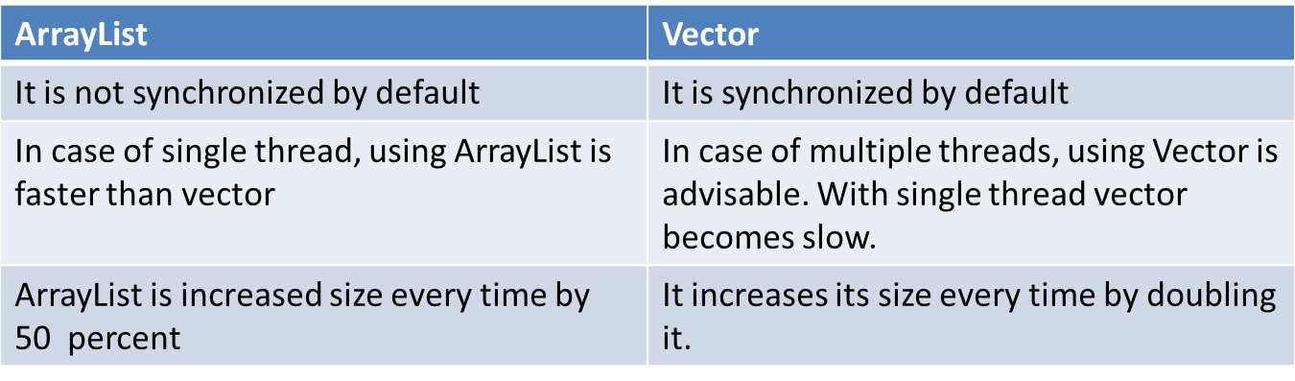
Difference between Vector and ArrayList
Interview question:
Can you synchronize the ArrayList objects?
Yes.we can use synchronizedList() method as
Collections. synchronizedList(new ArrayList());

Slide 15
when one thread is accessing a vector, and at the same time another thread tries to access it, an exception called ConcurrentModificationException is generated. Hence, this continuous use of lock for each operation makes vectors less efficient.
Traversal: Vector can use both Enumeration and Iterator for traversing over elements of vector while ArrayList can only use Iterator for traversing.
https://www.programiz.com/java-programming/vector

Slide 16
package com.collections.edu;
import java.util.ListIterator;
import java.util.Vector;
public class VectorDemo {
public static void main(String[] args) {
// TODO Auto-generated method stub
//Take a vector to store the Integers.
Vector<Integer> v = new Vector<>();
//take an int type array
int arr[]={10,20,30,40,50,60};
// when arr[i] is stored into vector v. arr[i]
for(int i=0;i<arr.length;i++)
{
v.add(arr[i]);
}
// retreiving the data using get method
for(int i =0;i<v.size();i++)
{
System.out.println(v.get(i));
}
System.out.println(v);
// by using ListIterator
//Retrieve using ListIterator:
System.out.println("using ListIterator");
ListIterator lit= v.listIterator();
System.out.println("Printing in forward direction");
while (lit.hasNext())
{
System.out.print(lit.next() + "\t");
}
System.out.println("\nPrinting in reverse direction");
while (lit.hasPrevious())
{
System.out.print(lit.previous() + "\t");
}
}
}

Slide 17
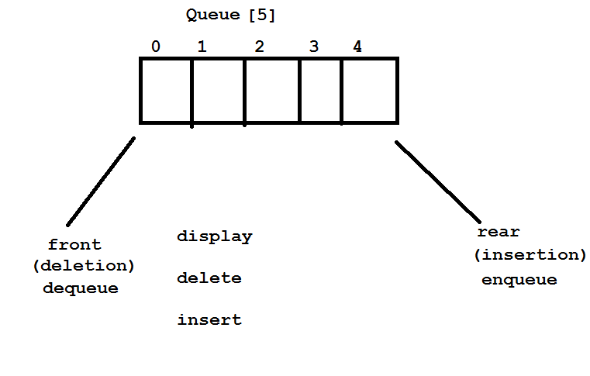
Queue
A Queue is a First In First Out (FIFO) data structure. It models a queue in real-life. Yes, the one that you might have seen in front of a movie theater, a shopping mall, a metro, or a bus

Slide 18
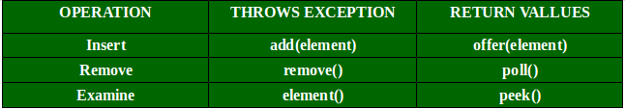
Methods in Queue:
add()- This method is used to add elements at the tail of queue. More specifically, at the last of linked-list if it is used, or according to the priority in case of priority queue implementation.
peek()- This method is used to view the head of queue without removing it. It returns Null if the queue is empty.
element()- This method is similar to peek(). It throws NoSuchElementException when the queue is empty.
remove()- This method removes and returns the head of the queue. It throws NoSuchElementException when the queue is empty.
poll()- This method removes and returns the head of the queue. It returns null if the queue is empty.
size()- This method return the no. of elements in the queue.

Slide 19
package com.collections.edu;
//Java orogram to demonstrate working of Queue
//interface in Java
import java.util.LinkedList;
import java.util.Queue;
public class QueueExample
{
public static void main(String[] args)
{
Queue<Integer> q = new LinkedList<>();
// Adds elements {0, 1, 2, 3, 4} to queue
for (int i=0; i<5; i++)
q.add(i);
// Display contents of the queue.
System.out.println("Elements of queue-"+q);
// To remove the head of queue.
int removedele = q.remove();
System.out.println("removed element-" + removedele);
System.out.println(q);
// To view the head of queue
int head = q.peek();
System.out.println("head of queue-" + head);
// Rest all methods of collection interface,
// Like size and contains can be used with this
// implementation.
int size = q.size();
System.out.println("Size of queue-" + size);
// To add the element at rear.
q.add(8);
System.out.println(q);
}
}

Slide 20
HashMap class
HashMap is a collection that stores the elements in the form of key value pairs.
If key is provided the corresponding value can be easily retrieved from the Hash Map.
Keys should be unique.(duplicate keys not allowed).
Hash Map is not synchronized.(using multiple thread results unreliable results)
class HashMap<K,V>
Where k is represents the type of key and v represent the type of value v.

Slide 21
In order to create a hash map, we must import the java.util.HashMap package first. Once we import the package, here is how we can create hashmaps in Java.
// HashMap creation with 8 capacity and 0.6 load factor HashMap<Key, Value>
numbers = new HashMap<>(8, 0.6f); In the above code, we have created a hashmap named numbers.
Here,
Key - a unique identifier used to associate each element (value) in a map
Value - elements associated by keys in a map
Notice the part new HashMap<>(8, 0.6). Here, the first parameter is capacity and the second parameter is loadFactor.
capacity - The capacity of this hash map is 8. Meaning, it can store 8 entries.
loadFactor - The load factor of this hashmap is 0.6. This means, whenever our hash table is filled by 60%, the entries are moved to a new hash table of double the size of the original hash table.
Default capacity and load factor
It's possible to create a hashmap without defining its capacity and load factor. For example,
// HashMap with default capacity and load factor HashMap<Key, Value> numbers1 = new HashMap<>(); By default,
the capacity of the hash map will be 16
the load factor will be 0.75

Slide 22
Methods of HashMap
The HashMap class provides various methods that allow us to perform various operations on the map.
Insert Elements to HashMap
put() - inserts the specified key/value mapping to the map
putAll() - inserts all the entries from specified map to this map
putIfAbsent() - inserts the specified key/value mapping to the map if the specified key is not present in the map
Access HashMap Elements
1. Using entrySet(), keySet() and values()
entrySet() - returns a set of all the key/value mapping of the map
keySet() - returns a set of all the keys of the map
values() - returns a set of all the values of the map
Using get() and getOrDefault()
get() - Returns the value associated with the specified key. Returns null if the key is not found.
getOrDefault() - Returns the value associated with the specified key. Returns the specified default value if the key is not found.

Slide 23
Remove Elements
remove(key) - returns and removes the entry associated with the specified key from the map
remove(key, value) - removes the entry from the map only if the specified key mapped to the specified value and return a boolean value
Replace Elements
replace(key, value) - replaces the value associated with the specified key by a new value
replace(key, old, new) - replaces the old value with the new value only if old value is already associated with the specified key
replaceAll(function) - replaces each value of the map with the result of the specified function
https://www.programiz.com/java-programming/hashmap

Slide 24
Differences between HashMap and HashTable
HashMap | Hashtable
HashMap is not synchronized by default | Hashtable is synchronized by default.
In case of single thread, using HashMap is faster than the Hashtable | In case of multiple threads, using hashtable is advisable. With single thread it becomes slow
HashMap allows null keys and null values to be stored. | Hashtable does not allow null keys and null values
Iterator in the hashmap is fail-fast. This means iterator will produce exception if concurrent updates are made on Hashmap | Enumeration for the hashtable is not fail fast. This means even if concurrent updates are done to Hashtable, there will not be any incorrect results produced by the Enumeration

Slide 25
Difference between Set and List
We can make HashMap synchronized by using
Collections.synchronizedMap(new HashMap());
https://www.codota.com/
Set | List
A set represents a collection of elements and order of the elements may change in the set | A List represents a ordered collection of elements and order of the elements in which they entered are preserved or maintained
Set will not allow duplicate values to be stored | List will allow duplicate values to be stored
Accessing elements by using index(position number) is not possible in case of sets. | Accessing elements by index is possible in lists
Set will not allow null elements | It will allow null elements to be stored.

